Slide 1
ToolChain
Code generation

Slide 2
Code generation
Code generation is possible due to :
All Resources are defined in an machine readable format
Using OpenAPI 2.0 definitions
Defines resource by:
Which operations are supported (RETRIEVE, UPDATE, ..)
Schema definition of the payload per operation
An example of the payload
Define which query parameters are applicable

Slide 3
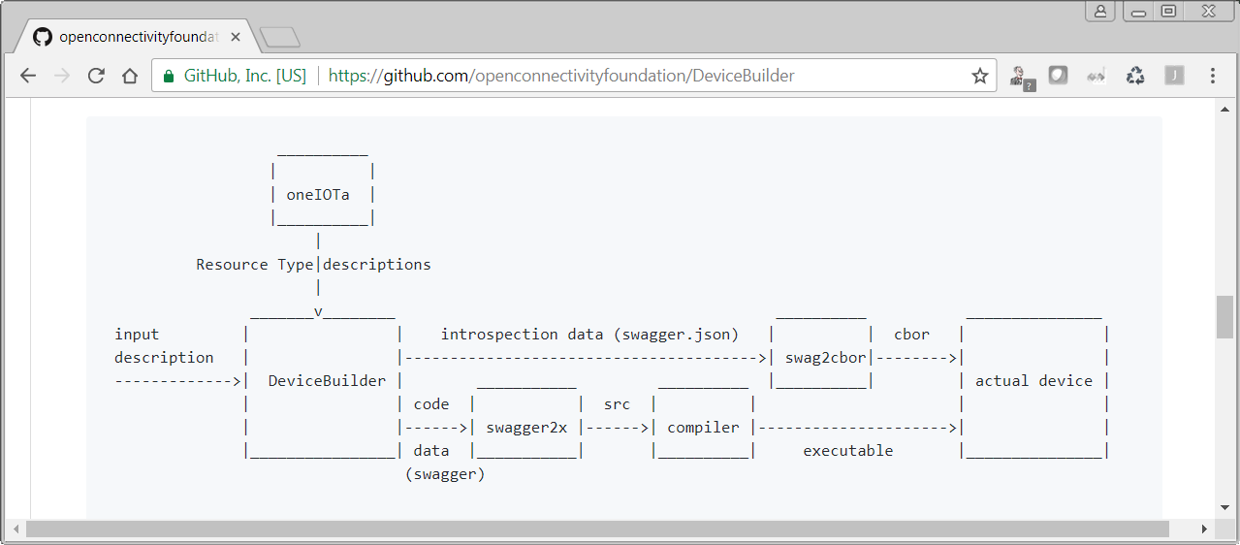
The DeviceBuilder tool chain

Slide 4
The DeviceBuilder toolchain
The DeviceBuilder tool chain consist of a set of python scripts glued together with bash scripts.
The script installs the necessary depended info it needs:
Git repos
Install python3 packages using pip3
The chain works on Linux and on Window (using git bash).
The chain will be used on a raspberry pi

Slide 5
DeviceBuilder
Python script to merge the resources to be used into a single file.
Takes an set of resources that will be used in the implementation
Combines swagger resource files into 1 large swagger file
Renames paths and removes properties while processing.
Does this for optional core resources and all resources in oneIOTa.
Mandatory resources (core and security) are not processed.
Input: file with resources to be implemented
Output: swagger file that list all “application level” resources
All resources that the application needs to implement to function correctly.

Slide 6
swagger2x
Create code by means of template technology
Can used jinja2 template technology because OpenAPI 2.0 == JSON
Add a bit of glue so that JSON constructs can be converted into correct code
Jinja2 constructs allows to loop over the DOM of the swagger file
Convert by means of instructions in template all the info of the swagger file into code
The “clever bit” is in the template, it is an mix of the target code and template language
An template is targeted for an specific code base
Multiple templates can co-exist, hence the tool can support all languages/APIs
Target: C IOTivity-Lite API.
Input: generated swagger file from DeviceBuilder
Output: C code!

Slide 7
Introspection generation
json2cbor
Tool to convert json to cbor (and visa versa)
Used as first step to create cbor of the introspection file
cbor2include
Utility to create include files from cbor
Only used to convert the cbor introspection file into an include file
Note:
Include file is updated when code generation is done.
Hence it will always reflect the implementation
It will be updated in the tree, hence each build will have an updated introspection device data.

Slide 8
Single script
Single bash script uses the python scripts to create code
Input:
Input file with the wanted resources
Output directory
Which device type is being implemented
For example:
sh DeviceBuilder_IotivityLiteServer.sh ../input-lightdevice.json ../lightdevice "oic.d.light"

Slide 9
What do you get?
After running the DeviceBuilder script:
Output Directory with:
Code currently based on C API of IOTivity-Lite 1.3.1
Introspection file that matches the implementation
Available in JSON and CBOR (converted from JSON)
Initial just works security file
Just a copy of an existing file
Problem: how to build this code

Slide 10
Build environment: IOTivity-Lite-setup
Github repo that uses IOTivity-Lite v1.3-rel as build environment and sets up the device builder tool chain to build an application
This github repo sets up an “work area”
Installs tools/code/etc to build an IOTivity-Lite server application
Linux
raspberry pi
This includes installing a copy of the IOTivity-Lite code
Github to install the environment resides at:
https://github.com/openconnectivity/IOTivity-Lite-setup

Slide 11
IOTivity-Lite-setup github repo
The repo has setup scripts for:
Setting up IOTivity-Lite with code and build environment
IOTivity version: 1.3-rel
Sets it up in local folder
Setting up DeviceBuilder
Relative to IOTivity-Lite folder
Setting up MRAA to interact with the hardware
Everything is set up by executing:
curl https://openconnectivity.github.io/IOTivity-Lite-setup/install.sh | bash

Slide 12
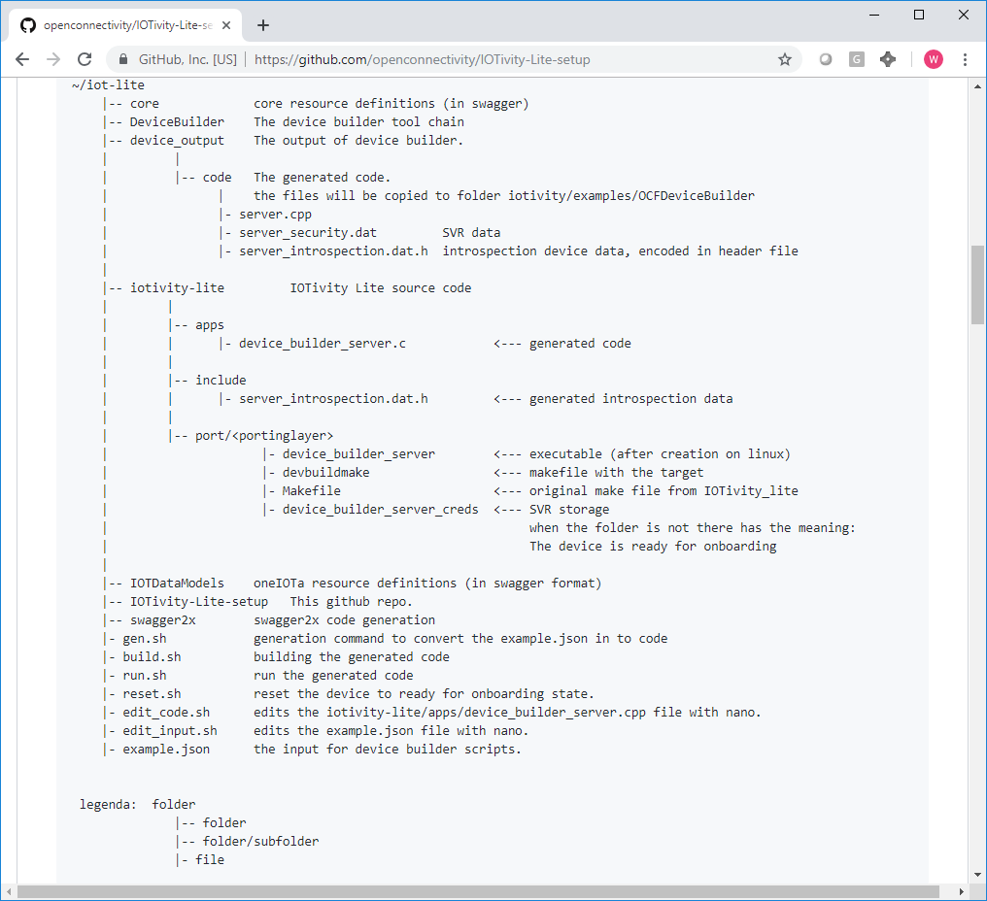
Folder structure
All folders are placed in the top folder
In this case ~/iot-lite

Slide 13
Preconfigured commands (in iot-lite folder)
Generate code with gen.sh
Compile code with build.sh
Edit code with edit_code.sh (using nano, editing in the iotivity-lite tree)
Run code with run.sh
Reset to onboarding state with reset.sh
Using just works, script removes files from the iotivity-lite tree.
The scripts that are convenience wrappers around command line tools.
All paths, etc. are filled in.
Code is generated from example.json.
Code is generated in iotivity-lite/apps

Slide 14
Example input file: binary switch
[ {
"path" : "/binaryswitch",
"rt" : [ "oic.r.switch.binary" ],
"if" : ["oic.if.a", "oic.if.baseline" ],
"remove_properties" : [ "range", "step" , "id", "precision" ]
}, {
"path" : "/oic/p",
"rt" : [ "oic.wk.p" ],
"if" : ["oic.if.baseline", "oic.if.r" ],
"remove_properties" : [ "n", "range", "value", "step", "precision", "vid" ]
} ]
Path to be used
rt as look up value
Which interfaces are supported
Which properties you do not want
Needed for introspection

